Slide 1
Behind the magic of Linked Data
#FOSS4G-NOR
September 2014, Oslo
Antonio Armas Díaz
antonio.armas.diaz@norkart.no

Slide 2
Wikipedia defines Linked Data as "a term used to describe a recommended best practice for exposing, sharing, and connecting pieces of data, information, and knowledge on the Semantic Web using URIs and RDF.“
http://linkeddata.org/home
http:// URIs
RDF
OWL
SPARQL

Slide 3



Ontologies
Triples stores
Vocabularies
Raw data!
Leading the track

Slide 4
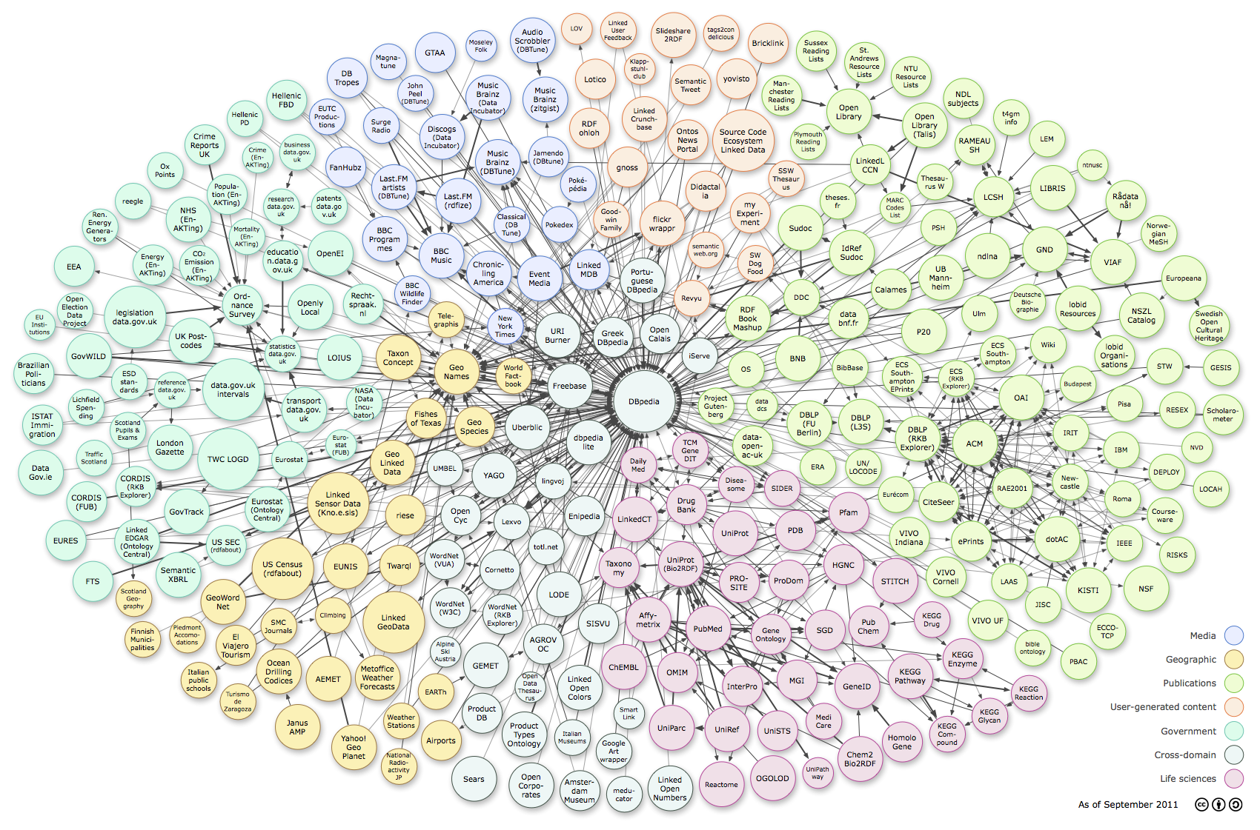
Cadastral Data
Basis for land tributes
Importance of geographical aspects (Annex I INSPIRE)
Geographical unit under homogeneous real property rights and unique ownership
Semantic integration efforts, connecting cadastral data with:
Public services, demographic statistics, planning...
Linked Open Data cloud diagram
from linkeddata.org

Slide 5






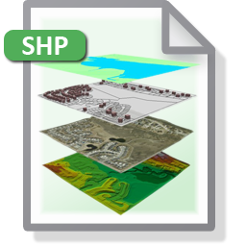
19152
19152
Cadastral Parcel
Specification
”Unlinked” data
Linked Data

Slide 6

Specification
Modelling
Steps:
RDF
Generation
Links
Generation
Integrating geographical information in the Linked Digital Earth.
International Journal of Digital Earth
Volume 7, Issue 7, 2014. Special Issue:
Digital Earth Applications:
Technological design and Organizational Strategies
Publication
http://www.tandfonline.com/doi/full/10.1080/17538947.2013.783127#.U6DKBxBdWrg

Slide 7
Geospatial information
Source: INSPIRE format GML files and the SHPs provided by Sede Electrónica del Catastro
https://www.sedecatastro.gob.es/
Geometry
“Simple features” GM_Surface (recommended by INSPIRE)
Data Specifications: INSPIRE_DataSpecification_CP_v3.0
Specification
Modelling
RDF
Generation
Links
Generation
Publication

Slide 8

Models Reused:
LADM OWL Ontology provided by the University of DELFT
(Peter Van Oosterom)
FAO (Foods and Agriculture Organization) OWL Geopolitical Ontology
GeoSPARQL Ontology
GeoLinkedData Ontology
WGS84 Vocabulary
Models built:
LADM_INSPIRE OWL Ontology from INSPIRE Data Models
Admin_Units_Spain Ontology
Specification
Modelling
RDF
Generation
NeOn methodology
LADM OWL Ontology
Links
Generation
Admin_Units_Spain Ontology
LADM_INSPIRE OWL Ontology
LADM_SPAIN OWL Ontology
Publication
GeoSPARQL Ontology
GeoLinkedData OWL Ontology

Slide 9
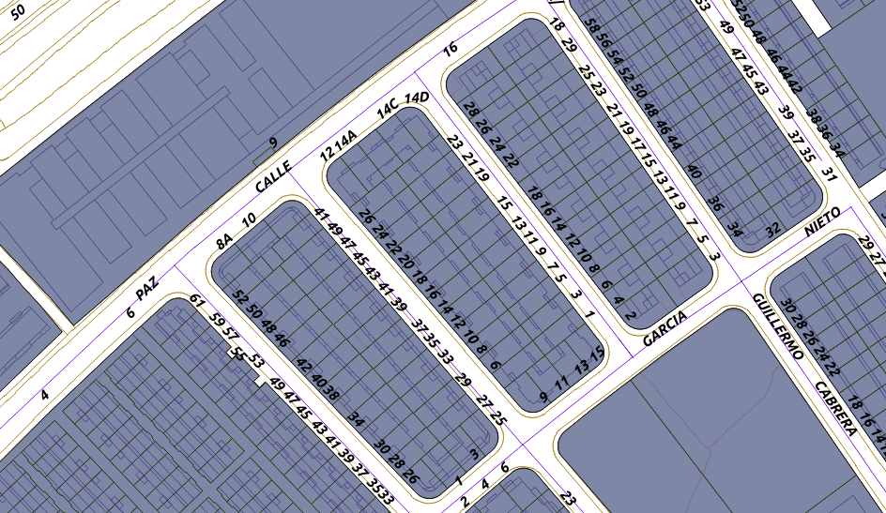

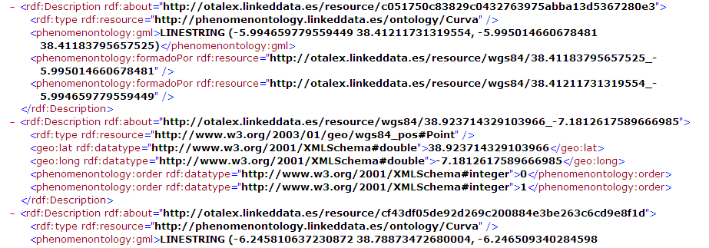
Specification
RDF Generation Generation of geospatial RDF
Modelling
From SHP to RDF Using shp2RDF library
and geometry2RDF library
RDF
Generation
Links
Generation
Publication

Slide 10
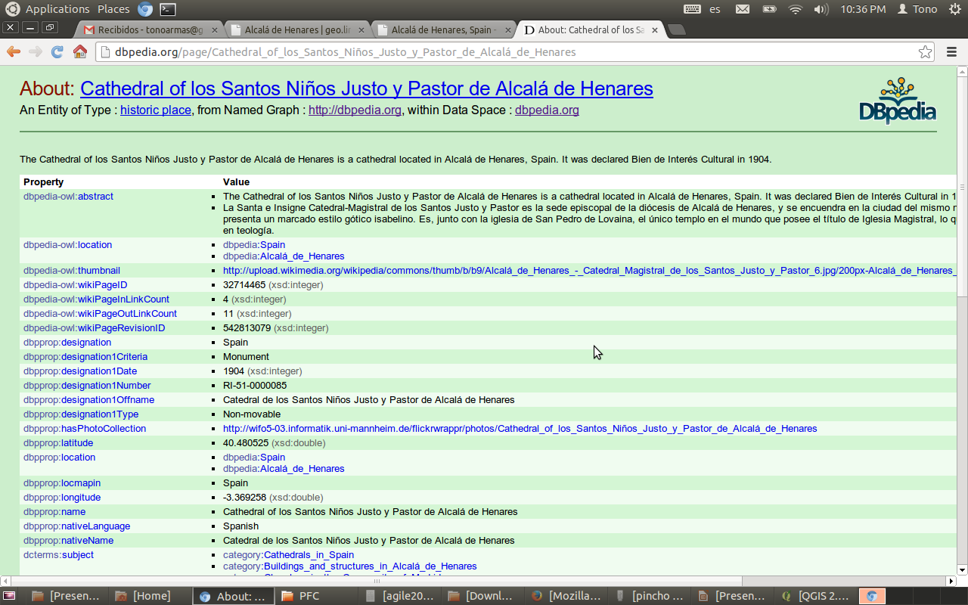
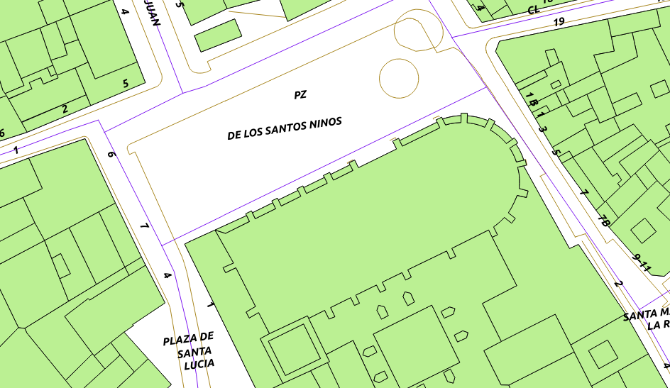
Specification
Link Generation with:
Silk
GIS tools
Modelling
RDF
Generation
Links
Generation
http://dbpedia.org/
RDF catastro
Publication
SameAs
SameAs
URI: http://catastroLinkedData/8813801VK6881S
10

Slide 11
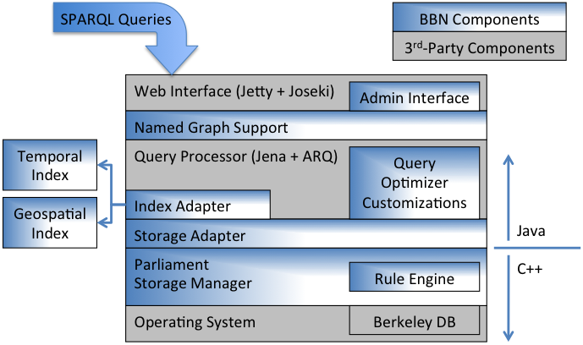
Specification
Parliament supports GeoSPARQL
Modelling
RDF
Generation
Links
Generation
Publication
http://parliament.semwebcentral.org/

Slide 12
Main results
An ontology network related to the LADM ISO19152 and
INSPIRE Cadastral Parcel Specifications
From unstructured cadastral data to Linked Open Data
Enriching Cadastral Data with Dbpedia
Objectives
Enriching Cadastral data with more datasets (Statistics and
most relevant INSPIRE themes)

Slide 13
Thank you for your attention!
antonio.armas.diaz@norkart.no

